Slide 1



Office Scripts
July 2020
Nancy Wang
Program Manager
Office Platform
Daniel Wilson
Program Manager
Office Platform
Sudhi Ramamurthy
Program Manager
Office Platform

Slide 2
Let us know what you think..
Short anonymous survey to collect your feedback of features:
  https://aka.ms/os-survey1 65devprogram

Slide 3
Overview

Slide 4
What is Office Scripts?
How can I use Office Scripts?
Why use Office Scripts?

Slide 5
What is Office Scripts?
How can I use Office Scripts?
Why use Office Scripts?

Slide 6

Mission
Empower Office users to easily automate tasks and to run their businesses efficiently anytime, anywhere.
Notes:
Danny

Slide 7
Core capabilities of Office Scripts
Enable Office
Scripts
Record actions
in Excel on the web
Edit script
code
Run scripts in the browser
Notes:
Sudhi

Slide 8
Latest developments
Simplified APIs
Power Automate integration
Secure script sharing
Notes:
Sudhi

Slide 9
What is Office Scripts?
How can I use Office Scripts?
Why use Office Scripts?

Slide 10
Programmability in Office today
End-user approachable
VBA | Office scripts
COM add-ins | Web add-ins
Desktop and Individual
Web and Collab
Pro dev audience
Notes:
Danny
We know there is a need for automation:
Nearly 1 in 6 Excel users use documents that contain macros
VBA powered documents have 8% higher retention rate
VBA continues to be a great way to automate on win32 and Mac

Slide 11
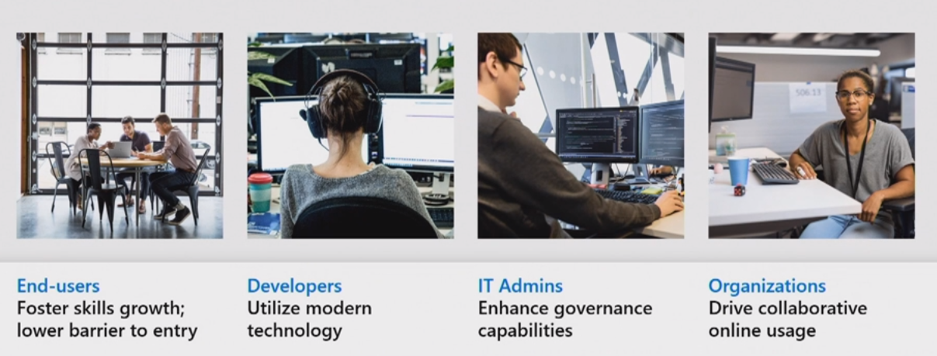

Slide 12
What is Office Scripts?
How can I use Office Scripts?
Why use Office Scripts?

Slide 13
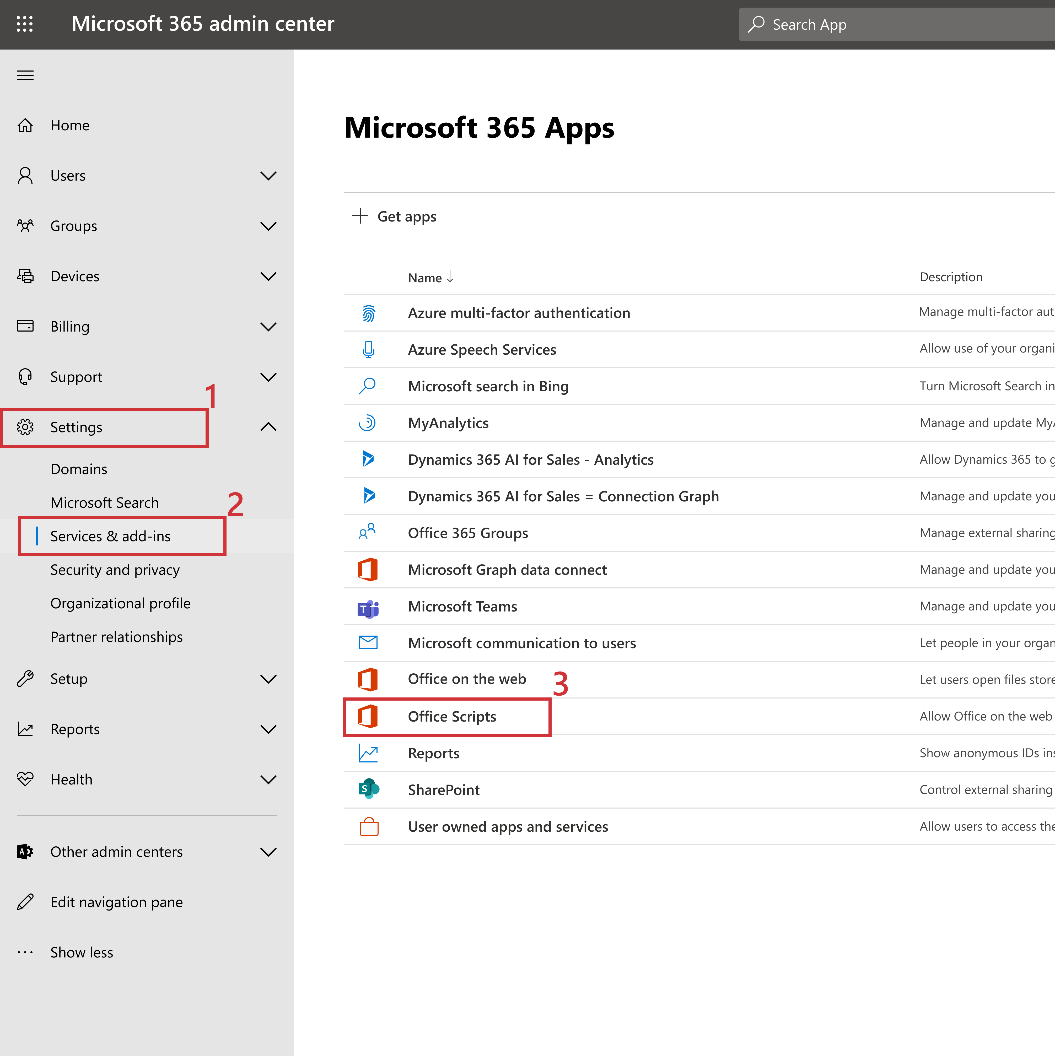
Steps to get started
IT admin will need to enable the scripting platform through the admin center
Automate tab should now be visible
Notes:
Sudhi
This is available today—

Slide 14
Simplified API for Office Scripts

Slide 15
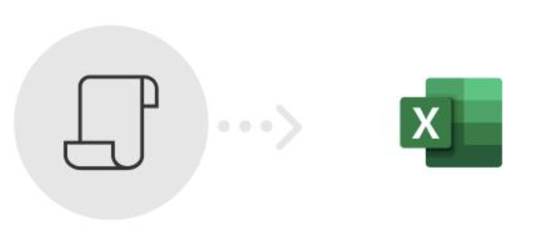
Scripting with Office Scripts
  Office Scripts provides TypeScript language-based scripting environment.
    TypeScript is a typed superset of JavaScript language.
  Code editor with IntelliSence support.
  Office Scripts APIs are TypeScript API/interfaces that allows read/write operations with Excel workbooks.
  Actions are recorded as scripts using the Office Scripts APIs.
  Scripts can be edited; new scripts can be created from in-built code editor.
What is the scripting environment?

Slide 16

Simplified API for Office Scripts
New simplified API model for Office Scripts.
It is now easier to get started and automate your tasks in Office Scripts by using a simplified the API surface.
Same benefits of previous model: recording actions and using full breadth of the APIs – and yet use a much easier model designed to suit both beginners and experienced users.
Introduced recently in public preview.
What is it?

Slide 17
Highlights of Simplified Office Scripts API
Office Scripts APIs can be invoked in synchronously - no promises or callbacks. ​
API design that provides:
    Simple methods, getter/setters
    Easy to access object collections as regular arrays.
    Better error handling options, and more.
New/improved for range cell, table row, and column.
Performance optimized for select scenarios.
  -- Static type checks offered by TypeScript --
What are the key benefits?

Slide 18
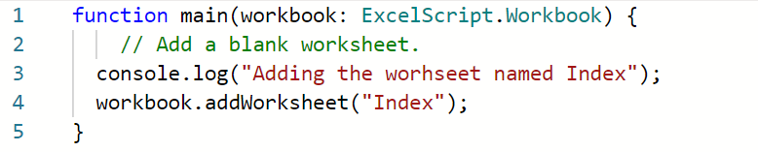
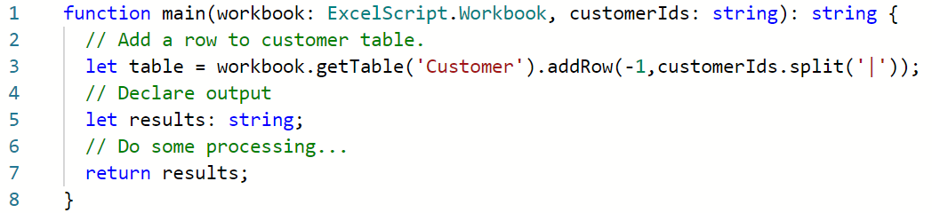
Office Scripts structure
main function is the entry point for scripts
Entry point
Workbook object is provided to main function
Type information
What does the script look like?
Your code goes here
Connect Excel with other parts of your workflow
Input
Output type
Return output

Slide 19
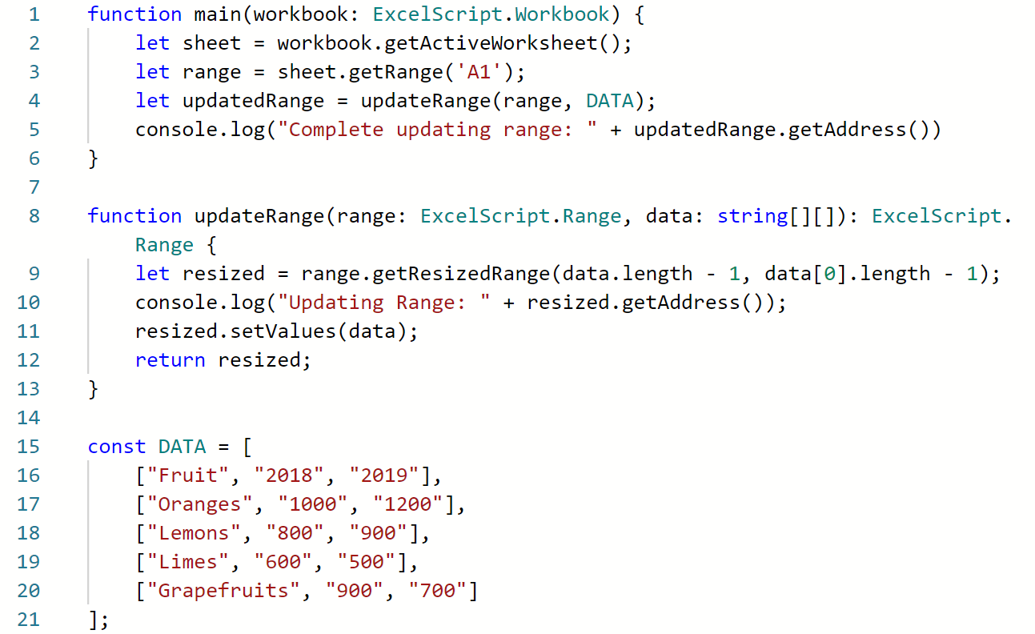
Office Scripts structure
Use functions to organize and re-use code
How do I organize my code?
Call function and receive output.
Function: performs action and returns output.
Return output.

Slide 20
Key API patterns
main function and parameters.
Object hierarchy and relationships.
Basic read, write data to/from workbook.
Method invocation on objects.
Collection (array) navigation and operations.
Object presence check.
- Use IntelliSence to discover APIs. -
What are the key API patterns?

Slide 21
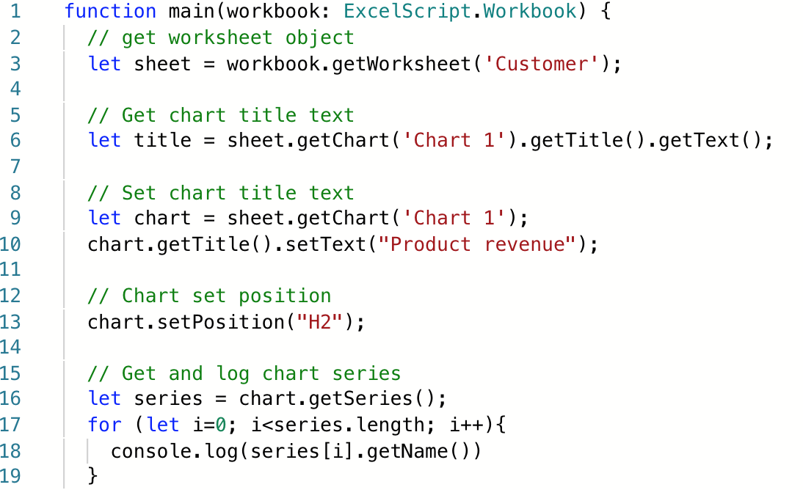
Key API patterns
What does the API syntax look like?

Slide 22
Demo

Slide 23
Clarifications about the simplified API
The simplified API model is only available for Office Scripts.
Office Scripts API is built using Office.js library, which drives the Office add-ins development.
Office.js asynchronous programming model will continue to drive add-ins development.
  Both models share similar object hierarchy, naming conventions, error conditions, etc. and roadmap.
  If you already have Office.js familiarity and knowledge – you can use that skill to ramp-up on Office Scripts.

Slide 24
Using Office Scripts with Power Automate

Slide 25
Resources

Slide 26
We welcome your feedback
You can try out Office Scripts today.
  Head over to Excel for the web (ensure your admin has enabled Office Scripts).
  Select Automate tab and try recording actions and editing/running scripts.
  Check-out sample scripts.
  Try Power Automation integration.
  Docs and sample material at: https://aka.ms/office-scripts
  Blog site: https://developer.microsoft.com/excel/blogs/
If you have any feedback or suggestions for the new Office Scripts feature, please let us know via User Voice. If you have any API usage related questions, ask your question on Stack Overflow and tag with [office-scripts].
If you have a problem with the Action Recorder or API, send feedback through the Help > Feedback button in Excel for the web.

Slide 27
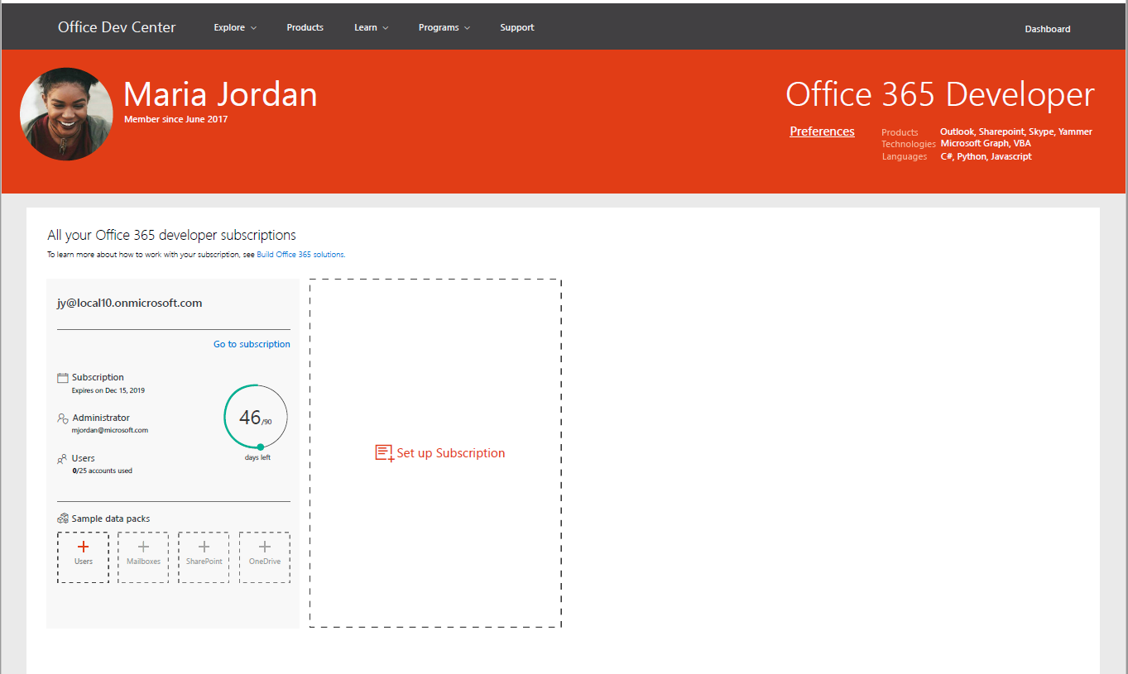
Join the Office 365 Developer Program
https://aka.ms/o365devprogram
Benefits
  Free renewable Office E5 subscription
  Be your own admin
  Dev sandbox creation tools
  Preload sample users and data for Microsoft Graph, and more
  Access to Microsoft 365 experts
  Join bootcamps and monthly community calls
  Tools, training and documentation
  Learn, discover and explore about Office 365 development
  Blogs, newsletters and social
  Stay up to date with the community

Slide 28
Let us know what you think..
Short anonymous survey to collect your feedback of features:
  https://aka.ms/os-survey1 65devprogram

Slide 29
Q&A

Slide 30

https://bit.ly/SessionEvaluationSurvey

