Slide 1
The Sultry 6
An affair with all 6 joins in
Power Query
Oz du Soleil
Excel MVP, LinkedIn Instructor LinkedIn: OzData | Twitter: @OzExcel | YouTube: Excel on Fire

Slide 2
INVITED
Calvin
Ellie
Irrfan
Jada
Sig
Teena
Trout
ATTENDED
Ellie
Flo
Irrfan
Jada
Keith
Rosa
Sig
Teena

Slide 3
INVITED
Calvin
Ellie
Irrfan
Jada
Sig
Teena
Trout
ATTENDED
Ellie
Flo
Irrfan
Jada
Keith
Rosa
Sig
Teena

Slide 4
Invited &
Attended
Ellie
Irrfan
Jada
Sig
Teena
INVITED
Calvin
Trout
ATTENDED
Flo
Keith
Rosa

Slide 5
INVITED
LEFT
Calvin
Trout
ATTENDED
RIGHT
Flo
Keith
Rosa
Ellie
Irrfan
Jada
Sig
Teena

Slide 6
INVITED
Calvin
Trout
ATTENDED
Flo
Keith
Rosa
Ellie
Irrfan
Jada
Sig
Teena
Left Outer Join

Slide 7
INVITED
Calvin
Trout
ATTENDED
Flo
Keith
Rosa
Ellie
Irrfan
Jada
Sig
Teena
Right Outer Join

Slide 8
INVITED
Calvin
Trout
ATTENDED
Flo
Keith
Rosa
Ellie
Irrfan
Jada
Sig
Teena
Inner Join

Slide 9
INVITED
Calvin
Trout
ATTENDED
Flo
Keith
Rosa
Ellie
Irrfan
Jada
Sig
Teena
Left Anti Join

Slide 10
INVITED
Calvin
Trout
ATTENDED
Flo
Keith
Rosa
Ellie
Irrfan
Jada
Sig
Teena
Right Anti Join

Slide 11
INVITED
Calvin
Trout
ATTENDED
Flo
Keith
Rosa
Ellie
Irrfan
Jada
Sig
Teena
Full Outer Join

Slide 12
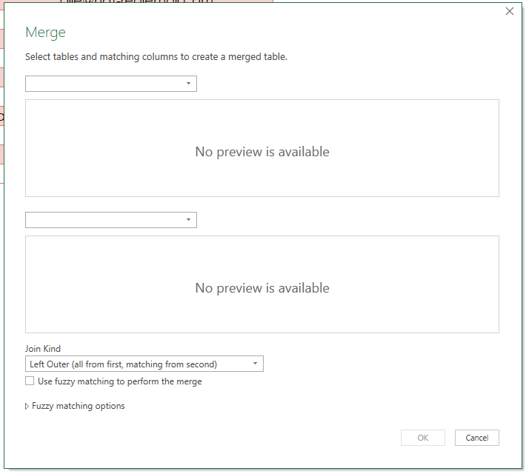
LEFT
Calvin Trout
LEFT
Ellie
Irrfan Jada
Sig
Teena
RIGHT
Flo Keith
Rosa
RIGHT

Slide 13
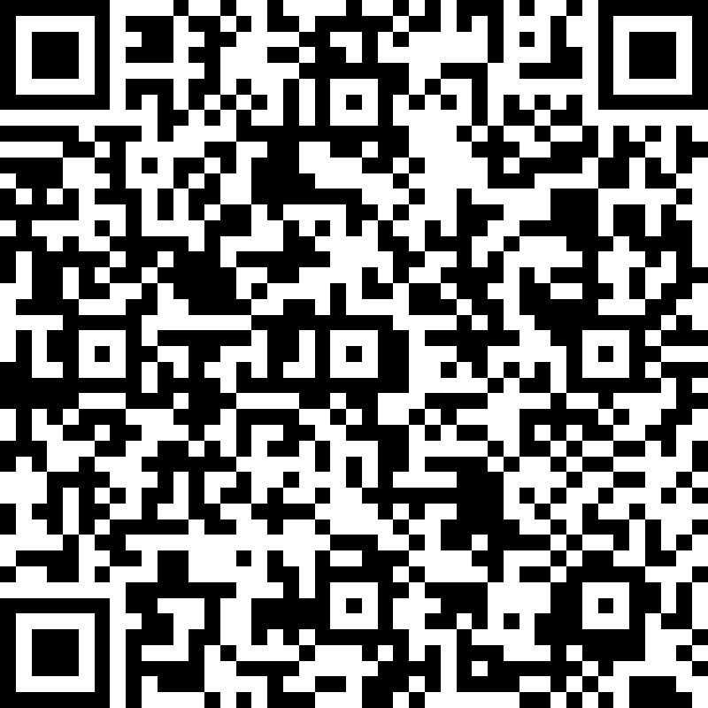
https://bit.ly/SessionEvaluationSurvey

