Slide 1
Smart macro recording
Jan Karel Pieterse
Excel expert, Microsoft Office & Apps MVP (Excel) https://jkp-ads.com | https://www.linkedin.com/in/jankarelpieterse
July 23, 2020

Slide 2
Content
Source file
Activating the developer tab
Recording a macro (demo)
Absolute and relative recording
Smart recording
Office Script recording (if there’s still time)
Q&A

Slide 3
The source file
Explain source file
Explain activating the developer tab
Make sure Excel and VBA Editor are side-by-side
Demo recording a macro

Slide 4
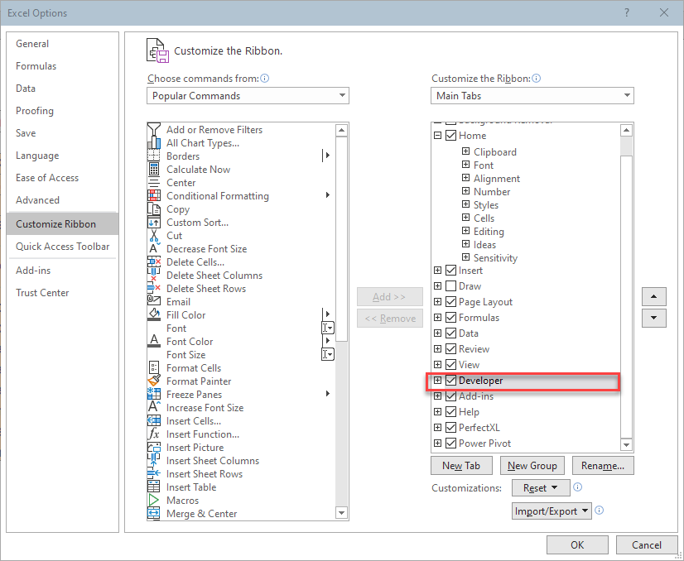
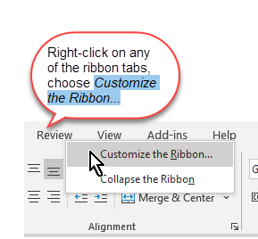
Activating the Developer tab
Enable the Developer tab:
Right-click a tab of the ribbon and choose Customize the Ribbon…
Check the box next to Developer

Slide 5
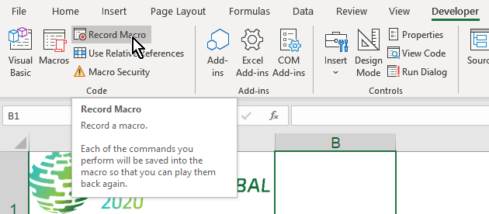
Recording a macro
Start the Macro recorder:

Slide 6
Recording a macro
Record macro with these steps:
Select data entry cells C2:C7
Copy
Select cell A2 of Call History
Paste special values and numberformats and transpose
Click on Form sheet, cell C4
Hit Escape
Stop recorder
Show macro code
Change entries and run macro, explain problem of overwriting the table row

Slide 7
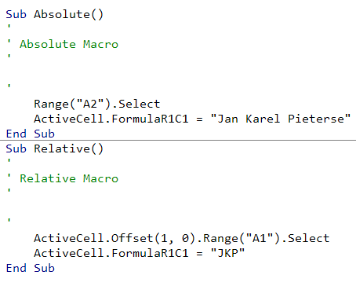
Absolute and relative recording
Start recording another macro and show what happens when we switch the absolute reference button, repeat the exact steps
Start in cell A1
Turn on recorder
Enter something in cell A2
Stop recorder, repeat from above, now enabling relative recording

Slide 8
Smart recording, Let’s do it!

Slide 9
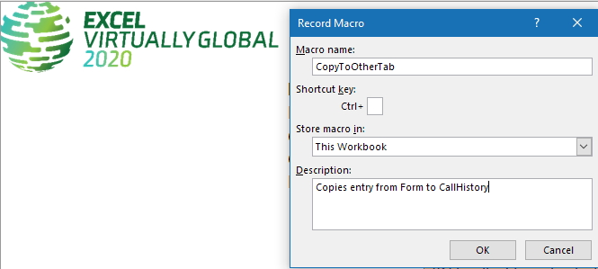
Recording a macro
Fill out the details of the macro:
Note the “Store Macro In” drop-down!

Slide 10
Smart recording, preparations
Position Excel and VBE next to each other
Create a shortlist of the steps you need to take
Practise the steps, see if your list is complete
(if needed, now undo your changes before proceeding to record)
Select sheet CallHistory, make sure there is one entry there
Press control+down arrow, down arrow
Explain what happens if A2 is empty
Select last cell column A, press control+Up, down

Slide 11
Smart recording
Select sheet CallHistory
Start the recorder
Set it to absolute recording
Make sure Module1 is visible
Select cells C2:C7
Click Copy button (mention control+c)
Select sheet CallHistory

Slide 12
Smart recording
Press control+down until bottom of sheet is reached
Press down arrow once more (cell A1048576)
Set Relative recording
Paste special transpose, values and number formats
Absolute recording
Activate Form sheet
Clear cells C4:C7
Select cell C4
Stop recording

Slide 13
Smart recording
Now test the macro
Explain about undo not working and why you should always save before testing

Slide 14
Spare time? Office Script recording
Open same file on office.com and try recording same macro there

Slide 15
Smart recording, Questions?

Slide 16
Required last slides

Slide 17
https://bit.ly/SessionEvaluationSurvey

Slide 19
Thank you
info@jkp-ads.com
https://jkp-ads.com https://www.linkedin.com/in/jankarelpieterse

