Slide 1
Building Faster Excel Solutions
Charles Williams
Excel MVP 2009-2020 The Excel Calculation Site: www.DecisionModels.com Excel & UDF Performance Stuff: FastExcel.wordpress.com

Slide 2
Agenda
Basic -> Intermediate -> Expert VBA users
How to make your VBA run 10 thousand times faster
Find your VBA bottlenecks with VBA Profiler
Life Beyond VBA: Other XL Extension Technologies

Slide 3
The Mountain between Excel & VBA

Slide 4
Speedup Summary
Switch off screen updating, calculation, avoid Select etc.
Avoid mountaineering with Variant arrays
Use .Value2 rather than .Value or .Text
Make Excel do the work
Use Range variables with worksheet functions
Use Doubles for arithmetic inside loops
String comparison is slow

Slide 5
Life Beyond VBA: Excel Extension Technologies

Slide 6
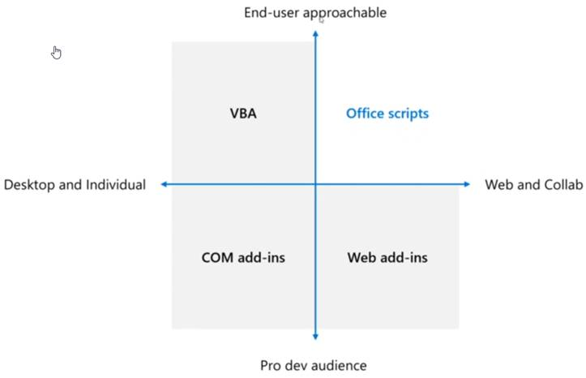
Beyond VBA: Office Scripts

Slide 7
Beyond VBA: Excel API Technologies

Slide 8
Beyond VBA: Excel Extension Toolsets

Slide 9
Life Beyond VBA – Other Sessions
Tony Roberts – PyXL - Python
Govert van Drimmelen – XL DNA - .NET
Keyur Patel – Office Addins – JS/TS
Grzegorz Stolecki – BERT - R
Sudhi Ramamurthy – Office Scripts – JS/TS

Slide 10
https://bit.ly/SessionEvaluationSurvey

